Slide 1
Statistics and Reliability: Module 6
Hypothesis Testing Handout
Notes:
Module Topics
Hypothesis Testing and Confidence Intervals
Tests of Evaluation
Tests of Comparison
Copyright (c) Deere & Company, as an unpublished work. This material is the property of Deere & Company. All use, disclosure, and/or reproduction not specifically authorized by Deere & Company is prohibited.

Slide 2
Statistical Methods
Descriptive Statistics
Inferential Statistics
Hypothesis Testing
Confidence Intervals
Notes:
Hypothesis Testing and Confidence Intervals
Statistical methods can be broken down into two branches: descriptive statistics, which was covered in a previous section, and inferential statistics.
Inferential statistics can be further broken down into two branches: hypothesis testing and confidence intervals.
This section will explain both and show how they are similar (the same?).
This section is a prerequisite for:
Tests of Evaluation (one-sample hypothesis testing)
Tests of Comparison (two-sample hypothesis testing)
Planning Tests of Evaluation (one-sample hypothesis testing sample size)

Slide 3
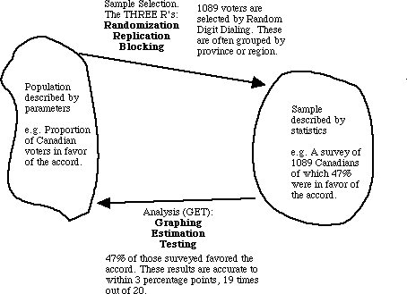
Notes:
Hypothesis Testing
Hypothesis testing is the process of taking a practical problem and translating it to a statistical problem.
Because we are using samples (and relatively small ones at that) to estimate population parameters, we are allowing for a level of uncertainty in our estimates.
Inferential statistics, with some assumptions, allow us to quantify this uncertainty.
Totally eliminating the uncertainty would require examining 100% of the population.
Above is a common example of hypothesis testing.
Have you ever received a phone call asking for whom you intend to vote?

Slide 4
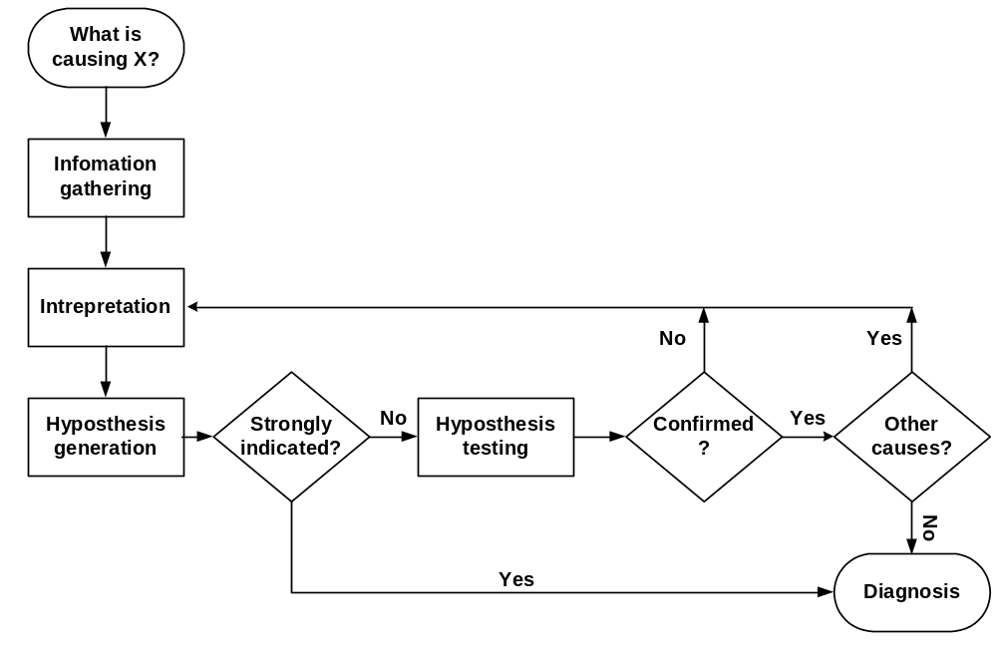

The Diagnostic Process
Law & Order – 10/9 PM Wednesdays on NBC
Notes:
This flowchart shows a universal diagnostic process, also known as “problem solving.” It is used by the medical industry, both EMS and doctors, the criminal justice industry, and may others. If you want to see a simulation of this process, watch any episode of “Law & Order.” Each show does this in 1 hour.
Is this how you solve problems at your location?
The key point is that this flowchart shows hypothesis generation and hypothesis testing in their proper context for solving problems.
Technically, a hypothesis is a tentative assumption made in order to test a theory to its logical or empirical conclusion (see http://en.wikipedia.org/wiki/Hypothesis for more information). In statistics, it is an assumption about a population parameter, e.g., population mean, proportion, variance, etc. And it should be stated before analysis.
There are two types of hypotheses in hypothesis testing: “null” and “alternative.”

Slide 5
The Null Hypothesis: H₀
Equal to: =
Less than or equal to: <
Greater than or equal to: >
  Example: H₀: μ₁ = μ₂ , where:
  H₀ = the null hypothesis
  μ₁ = the mean of population 1, and
  μ₂ = the mean of population 2
Notes:
The null hypothesis is what is being tested (“Null” = No difference).
Always has equality sign: =, < , or >
Designated H₀
Specified as H₀: μ =, <, or > some value. Example, H₀: μ = 3
The Null Hypothesis (H₀) is assumed to be true. This is like the defendant assumed to be innocent. You are the prosecuting attorney; you must provide evidence that this assumption is probably not true.

Slide 6
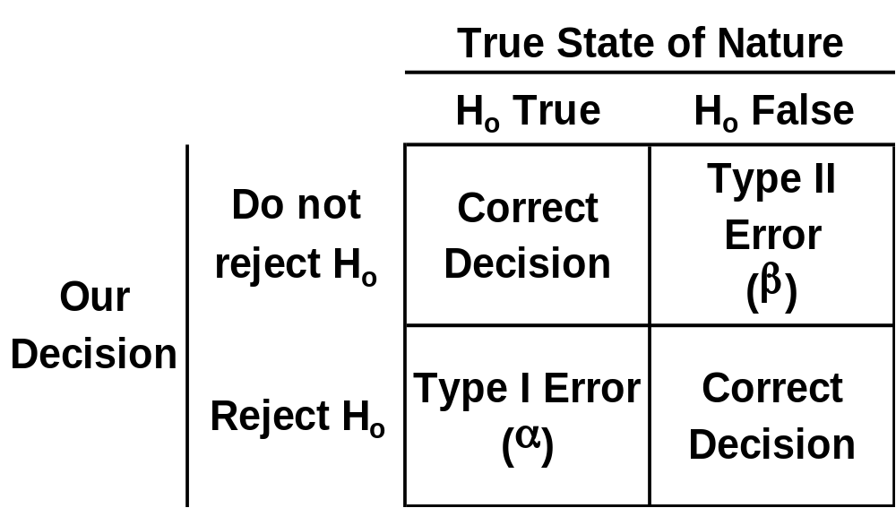
Statistical Hypothesis Testing
H_{o} = Hypothesis being tested
Notes:
There are two correct decisions one can make:
Do not reject H₀ when it is True; or
Reject H₀ when it is False
There are two errors one can make:
Don not reject H₀ when it is False; or
Reject H₀ when it is True

Slide 7

Alternative Hypothesis: H_{a}
Null
Alternative
≠
=
⇒
<
>
⇒
Null
Alternative
>
<
⇒
Notes:
The alternative hypothesis is the opposite of null hypothesis.
Always has inequality sign: ≠, <, or >
Designated H_{a} (or H₁)
Specified H_{a}: μ ≠, <, or > some value, e.g., H_{a}: μ ≠ 3

Slide 8
Identifying Hypotheses Examples
Is the population mean different from 3?
  1. μ ≠ 3
  2. μ = 3
  3. H_{a}: μ ≠ 3
  4. H₀: μ = 3
Is the population mean greater than 3?
  1. μ > 3
  2. μ < 3
  3. H_{a}: μ > 3
  4. H₀: μ < 3
“Two-sided” or “Two-tailed” Test
“One-sided” or “One-tailed” Test
Notes:
Identifying Hypotheses Steps:
1. State question statistically
2. State opposite statistically - Must be mutually exclusive & exhaustive
3. Select & state alternative hypothesis - Has the ≠, < or > sign
4. State null hypothesis - Has the =, > or < sign

Slide 9
Identifying Hypotheses Examples
Is the population mean life different from 12 hours?
  1. μ ≠ 12
  2. μ  = 12
  3. H_{a}: μ ≠ 12
  4. H₀: μ = 12
Is the population mean life less than 12 hours?
  1. μ < 12
  2. μ > 12
  3. H_{a}: μ < 12
  4. H₀: μ > 12
“Two-sided” or “Two-tailed” Test
“One-sided” or “One-tailed” Test
Notes:
Again, Identifying Hypotheses Steps:
1. State question statistically
2. State opposite statistically - Must be mutually exclusive & exhaustive
3. Select & state alternative hypothesis - Has the ≠, < or > sign
4. State null hypothesis - Has the =, > or < sign

Slide 10
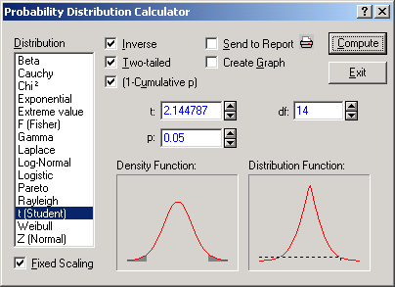
Notes:
Significance Level
Defines unlikely values of sample statistic if null hypothesis is true
Called rejection region of sampling distribution (a.k.a. Critical region)
Is a probability (0.0 < p < 1.0)
Denoted α (alpha)
Selected by researcher at start - typical values are 0.01, 0.05 and 0.10.
In Statistica, put α in the probability (“p”) field and look at the resulting critical value in the value field (“t” in this case).

Slide 11
Statistical Hypothesis Testing (2-sided)
Sampling Distribution
Level of Confidence
Rejection
Rejection
Region
Region
1 - α
α/2
α/2
Non-rejection
Region
H₀
Sample Statistic
Critical Value
Value
Critical Value
Notes:
Hypothesis Testing Rejection Regions: Two-sided version
Think of the game of football (either version: American and that other one).
The goal posts are some specified distance apart.
In games, this distance is determined by the rules of the game.
In statistics, the “rules of the game” are determined by our threshold of the amount of risk we are willing to take.
We set the “goal posts” such that the area in the tails equals some pre-specified value.
This establishes the amount of evidence against the null hypothesis that should be collected before we can make a decision.
For the two sided version, the value of α is divided into two parts: α/2 on the left side and α/2 on the right side.

Slide 12
Statistical Hypothesis Testing (2-sided)
Sampling Distribution
Level of Confidence
Rejection
Rejection
Region
Region
1 - α
α/2
α/2
Non-rejection
Region
H₀
Sample Statistic
Reject H₀ if in the either shaded region
Critical Value
Value
Critical Value
Do not reject H₀ if in this region
Notes:
Hypothesis Testing Rejection Regions: Two-sided version - continued
If the sample statistic falls in the non-rejection region, then we do not reject the null hypothesis.
Caution: just because we did not reject the null hypothesis does not mean it is true; it only means that we might not have gathered enough evidence to show that it is most likely not true.
Another way of thinking about this (the statistical way) is that due to the variability our data and the relatively small sample size, we expect our estimates to vary and we need a way to distinguish between the signal (difference) and the noise (no difference).
If the sample statistic falls in the rejection region, then we reject the null hypothesis.

Slide 13
Statistical Hypothesis Testing (1-sided)
Sampling Distribution
Level of Confidence
Rejection
Region
1 - α
α
Non-rejection
Region
H₀
Sample Statistic
Critical Value
Value
Notes:
Hypothesis Testing Rejection Regions: One-sided version
For the one-sided version, the value of α is not divided into two parts – it all goes to one side.

Slide 14
Statistical Hypothesis Testing (1-sided)
Sampling Distribution
Level of Confidence
Rejection
Region
1 - α
α
Non-rejection
Region
H₀
Sample Statistic
Reject H₀ if in this region
Critical Value
Value
Do not reject H₀ if in this region
Notes:
Hypothesis Testing Rejection Regions: One-sided version - continued
If the sample statistic falls in the non-rejection region, then we do not reject the null hypothesis.
If the sample statistic falls in the rejection region, then we reject the null hypothesis.

Slide 15
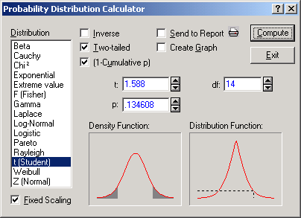
Notes:
p-Value
Probability of obtaining a test statistic more extreme (< or >) than the actual sample value given H₀ is true.
Called observed level of significance: smallest value of α for which H₀ can be rejected.
Used to make rejection decision:
If p-value > α, do not reject H₀
If p-value < α, reject H₀
In Statistica, put the sample statistic in the value field (“t” in this case) and look at the resulting probability (“p”).

Slide 16
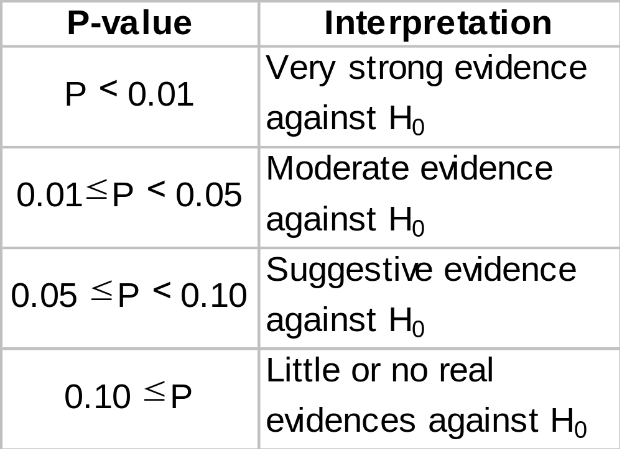
p-Value Interpreations
Notes:
How it works
After data is collected, we calculate a test statistic
If H₀ is true (no difference), then the test statistic is very small and has a high “p-value”
If H_{a} is true, the test statistic will be large and the “p-value” will be small
The “p-value” is the chance the results occurred when H₀ is true
The p-value is based on an assumed or actual reference distribution
Normal, t, chi-squared, F distribution, etc.
[http://home.ubalt.edu/ntsbarsh/Business-stat/opre504.htm]

Slide 17
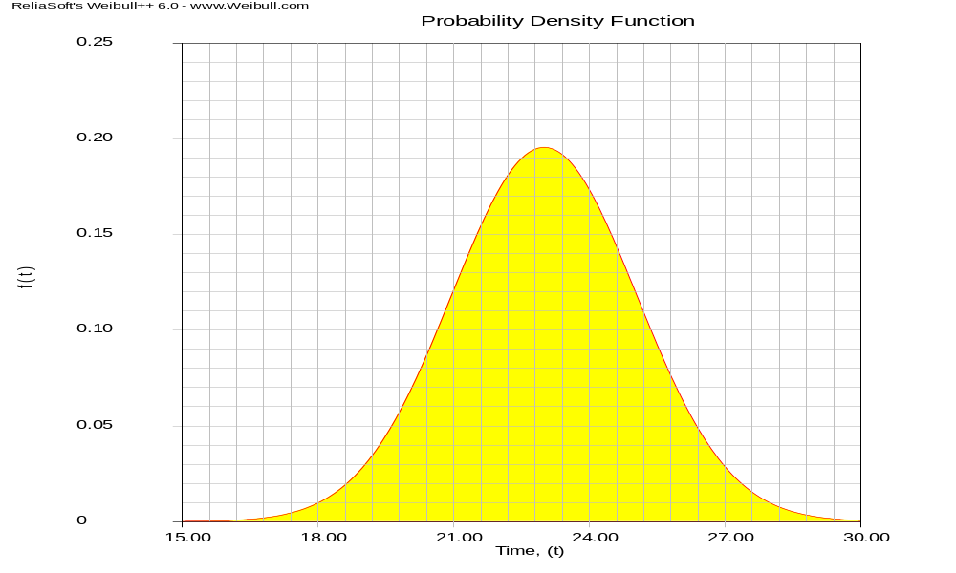
“True” Mean and Confidence Interval
95% Confidence Interval
0.025
0.025
LCL = 19
Sample Mean = 23
UCL = 27
Notes:
Probably the most often used descriptive statistic is the mean. The mean is a particularly informative measure of the "central tendency" of the variable if it is reported along with its confidence intervals. Usually we are interested in statistics (such as the mean) from our sample only to the extent to which they can infer information about the population. The confidence intervals for the mean give us a range of values around the mean where we expect the "true" (population) mean is located (with a given level of certainty).
For example, if the mean in your sample is 23, and the lower and upper limits of the p=.05 confidence interval are 19 and 27 respectively, then you can conclude that there is a 95% probability that the population mean is greater than 19 and lower than 27. If you set the p-level to a smaller value, then the interval would become wider thereby increasing the "certainty" of the estimate, and vice versa; as we all know from the weather forecast, the more "vague" the prediction (i.e., wider the confidence interval), the more likely it will materialize. Note that the width of the confidence interval depends on the sample size and on the variation of data values. The larger the sample size, the more reliable its mean. The larger the variation, the less reliable the mean. The calculation of confidence intervals is based on the assumption that the variable is normally distributed in the population. The estimate may not be valid if this assumption is not met, unless the sample size is large, say n=100 or more.

Slide 18
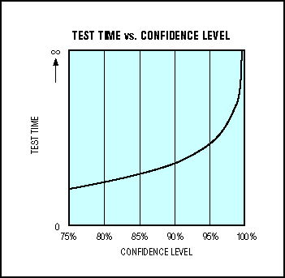
Confidence???
Notes:
[http://www.maxim-ic.com/appnotes.cfm/appnote_number/703/ln/en]
Common definitions of confidence: faith, trust (“their confidence in God’s mercy”); a feeling or consciousness of one’s powers or of reliance on one’s circumstances (“he had perfect confidence in his ability to succeed”); the quality or state of being certain (“they had every confidence of success”). [Webster’s New Collegiate Dictionary]
These are psychology based definitions.
Statistical confidence: the fraction of times the confidence interval will capture the true value if the experiment is hypothetically repeated a large number of times. Sometimes called “s-confidence” to distinguish it from the common definition or “engineering confidence.”

Slide 19
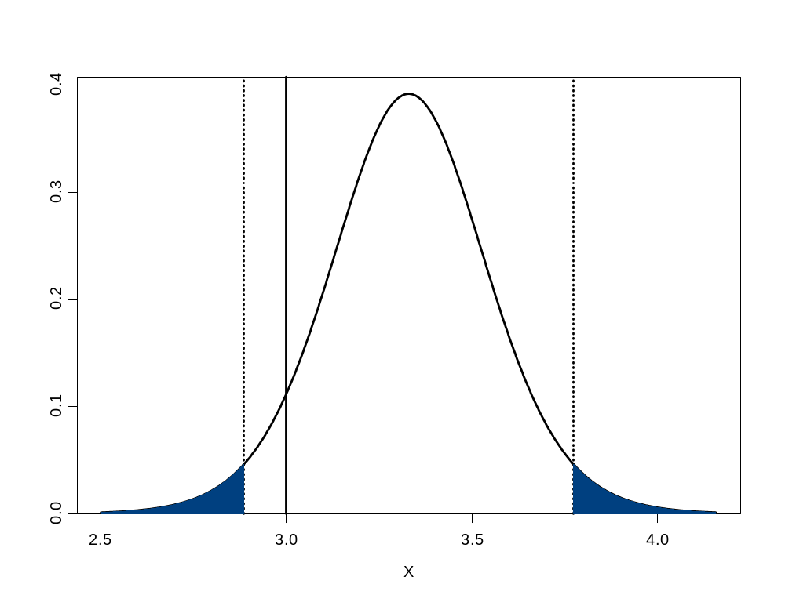
95% Confidence Interval
H₀: μ = 3
LCL = 2.89
UCL = 3.77
0.025
0.95
0.025
Notes:
Confidence Interval (CI): A group of continuous or discrete adjacent values that is used to estimate a statistical parameter (as a mean or variance) and that tends to include the true value of the parameter a predetermined portion of the time if the process of finding the group of values is repeated a number of times. Confidence intervals are used to make inferences about a population given data from a sample. [Webster’s New Collegiate Dictionary]
CI’s are defined such that: P(LCL < X < UCL) = 1 - α, where
LCL = Lower Confidence Limit and UCL = Upper Confidence Limit.
The concept of confidence intervals is quite difficult to grasp for beginners. For example, assume that our population parameter of interest is the population mean. What is the meaning of a 95% confidence interval in this situation? Many want to say that a 95% confidence interval means that there is a 95% chance that the confidence interval contains the population mean. But any particular confidence interval either contains the population mean, or it doesn’t. The confidence interval should not be interpreted as a probability. The correct interpretation is based on repeated sampling. If samples of the same size are drawn repeatedly from a population, and a confidence interval is calculated from each sample, then 95% of these intervals should contain the population mean.

Slide 20
Hypothesis Tests and Confidence Intervals
Rejection Region
Rejection Region
Hypothesis Test
1 - α
Nonrejection Region
α/2
α/2
H₀ Value
Critical Value
Critical Value
Sample Statistic
Rejection Region
Rejection Region
Confidence Interval
1 - α
Nonrejection Region
α/2
α/2
Sample Statistic
LCL
UCL
H₀ Value
Notes:
Hypothesis tests determine whether a sample statistic falls within a specified interval. Conversely, we can determine whether a specified value falls within the CI for the sample statistic.
There is an extremely close relationship between confidence intervals and hypothesis testing. When a 95% confidence interval is constructed, all values in the interval are considered plausible values for the parameter being estimated. Values outside the interval are rejected as implausible. If the value of the parameter specified by the null hypothesis is contained in the 95% interval then the null hypothesis cannot be rejected at the 0.05 level. If the value specified by the null hypothesis is not in the interval then the null hypothesis can be rejected at the 0.05 level. [http://www.ruf.rice.edu/~lane/hyperstat/B15183.html]
These methods are mathematically equivalent and should agree on the conclusion (assuming they make the same statistical assumptions). Some consider CIs to be more informative and more sound statistically, because the width of CIs shows uncertainty and CIs are based on data, not assumed distribution.
Sometimes CIs are easier to determine!

Slide 21
CI Approach
Two-sided: H₀: μ = μ₀ versus H₁: μ ≠ μ₀
1 - α
Do not reject H₀
α/2
α/2
LCL
X
UCL
μ₀
1 - α
Reject H₀
α/2
α/2
LCL
X
UCL
μ₀
Notes:
The two-sided CI is the easiest: just estimate the LCL and UCL and see where the hypothesized value falls.
If it falls inside the LCL and UCL, then do not reject the null hypothesis.
If it falls outside the LCL and UCL, then reject the null hypothesis.

Slide 22
CI Approach
One-sided: H₀: μ > μ₀ versus H₁: μ < μ₀
1 - α
Do not reject H₀
α
X
UCL
μ₀
1 - α
Reject H₀
α
X
UCL
μ₀
Notes:
One-sided CIs are more difficult: you need to determine in which direction to look.
Look at the alternative hypothesis. For this version, we are trying to determine if the actual mean is less than the hypothesized mean. Therefore, we want to see how large we would expect the sample value to be given the variability in the data and the sample size. This implies we should look at the UCL.
In this case, if the hypothesized value falls to the left of the UCL, then do not reject the null hypothesis; if it falls to the right of the UCL, then reject the null hypothesis.

Slide 23
CI Approach
One-sided: H₀: μ < μ₀ versus H₁: μ > μ₀
α
1 - α
Do not reject H₀
LCL
X
μ₀
α
1 - α
Reject H₀
LCL
X
μ₀
Notes:
For this version, we are trying to determine if the actual mean is greater than the hypothesized mean. Therefore, we want to see how small we would expect the sample value to be given the variability in the data and the sample size. This implies we should look at the LCL.
In this case, if the hypothesized value falls to the right of the LCL, then do not reject the null hypothesis; if it falls to the left of the LCL, then reject the null hypothesis.

Slide 24
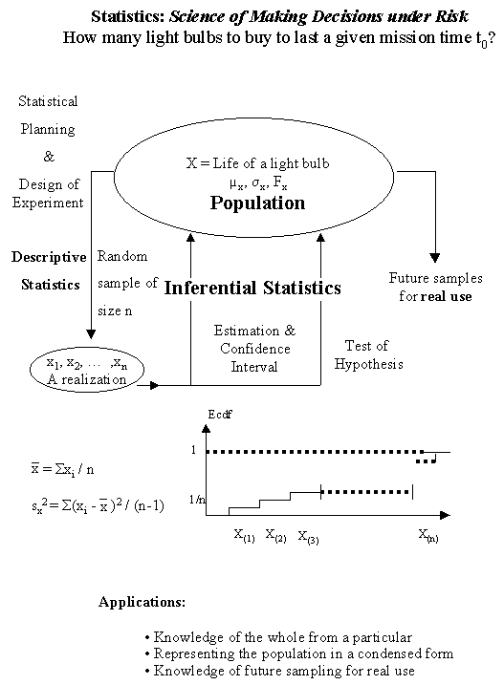
Notes:
[http://home.ubalt.edu/ntsbarsh/Business-stat/opre504.htm]
Review - Do you know what the following are:
Null Hypothesis?
Alternative Hypothesis?
Hypothesis test?
One- vs. Two-Sided?
Confidence interval?
One- vs. Two-sided?

Slide 25



Tests of Evaluation
Notes:
1-Sample Hypothesis Tests and Confidence Intervals: sampled from a hypothesized population versus sampled from a different population?
Outline
1-Sample t-Test
2-sided
1-sided
1-Sample χ² -Test
2-sided

Slide 26
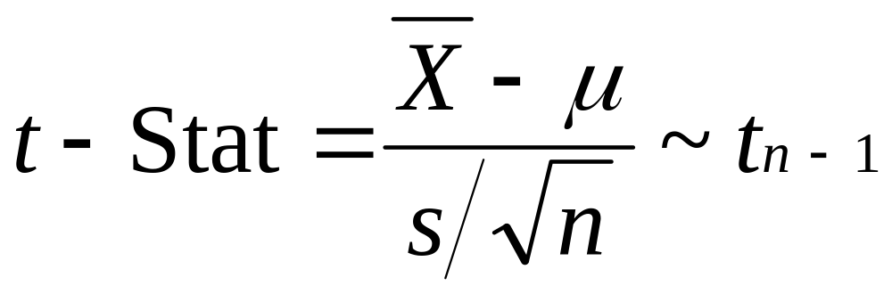
1-Sample t-Test
  X = Sample mean
  μ = Hypothesized mean
  s = Sample standard deviation
  n = Sample size
  df = degrees of freedom = n - 1
Notes:
Use with Normal data when standard deviation is unknown.
Test whether sample mean is equal to a hypothesized value.

Slide 27
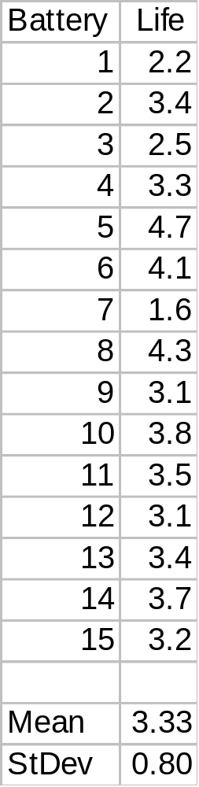

2-Sided t-Test Example
H₀: μ = 3 vs. H_{a}: μ ≠ 3
Notes:
Is the average life of a battery really 3 years?
A random sample of 15 batteries had a mean = 3.33 years and a standard deviation of 0.80 years.
Test using 95% confidence (α = 0.05).

Slide 28
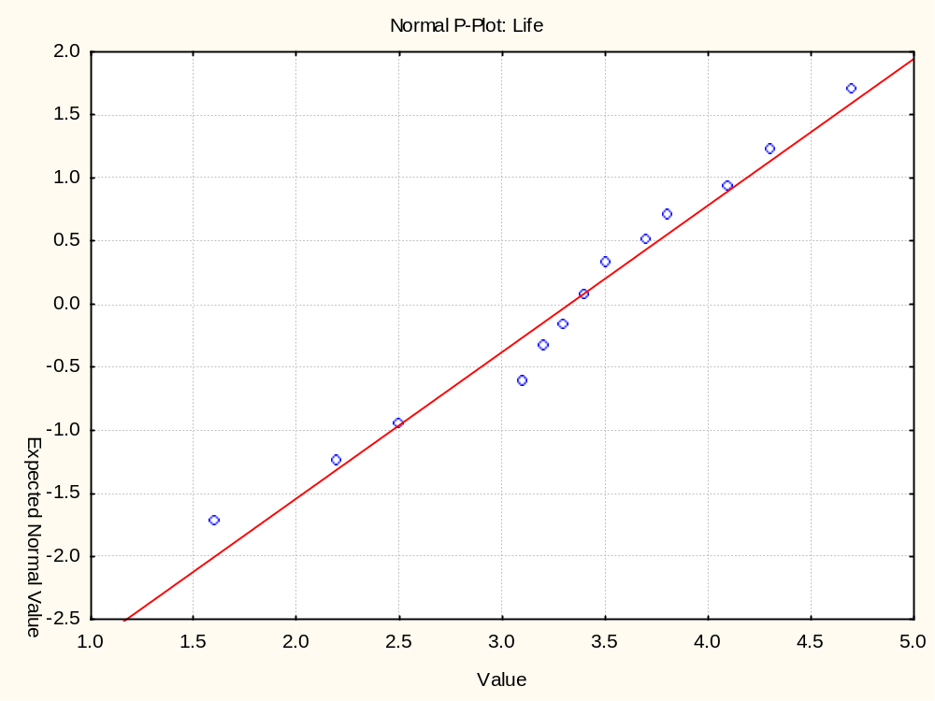
Notes:
1st Look at the Data
Use Statistics > Basic Statistics/Tables > Descriptive Statistics > Prob. & Scatterplots > Normal Probability Plot
The normal distribution appears to fit the battery life data.

Slide 29
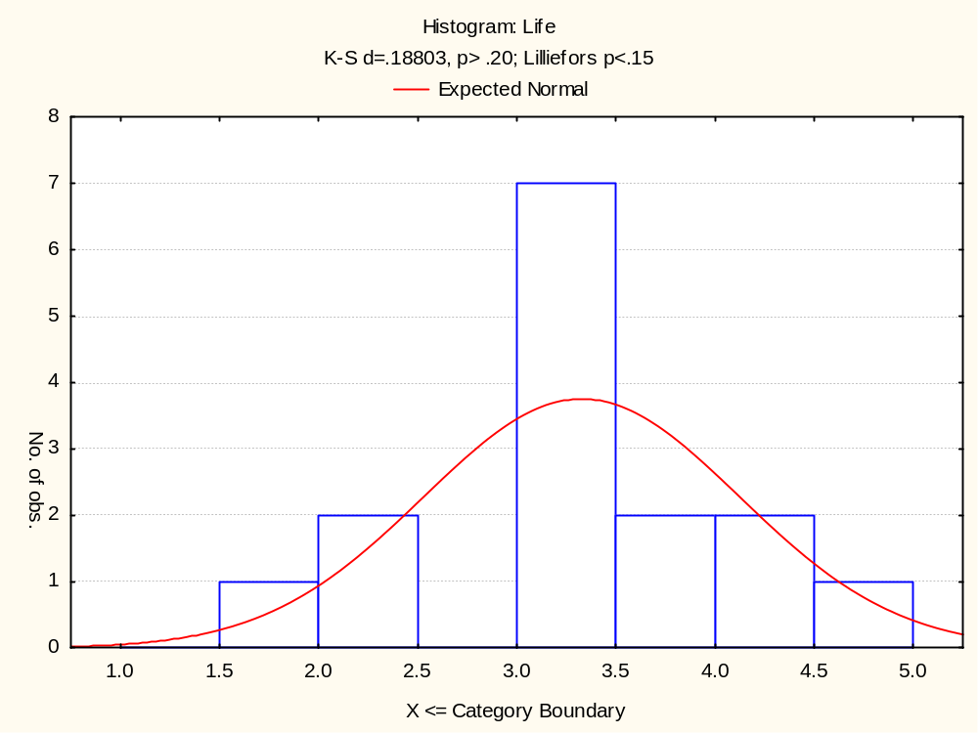
μ = 3?
Notes:
Here’s another view of the data:
Use Statistics > Basic Statistics/Tables > Descriptive Statistics > Quick > Histograms
Is the mean life equal to 3 years?

Slide 30
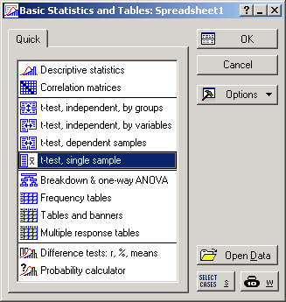
Notes:
Statistica Analysis
Statistics > Basic Statistics/Tables > t-test, single sample

Slide 31
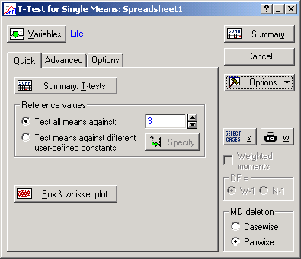
Notes:
Quick tab
First click the “Box & whisker plot” tab.

Slide 32
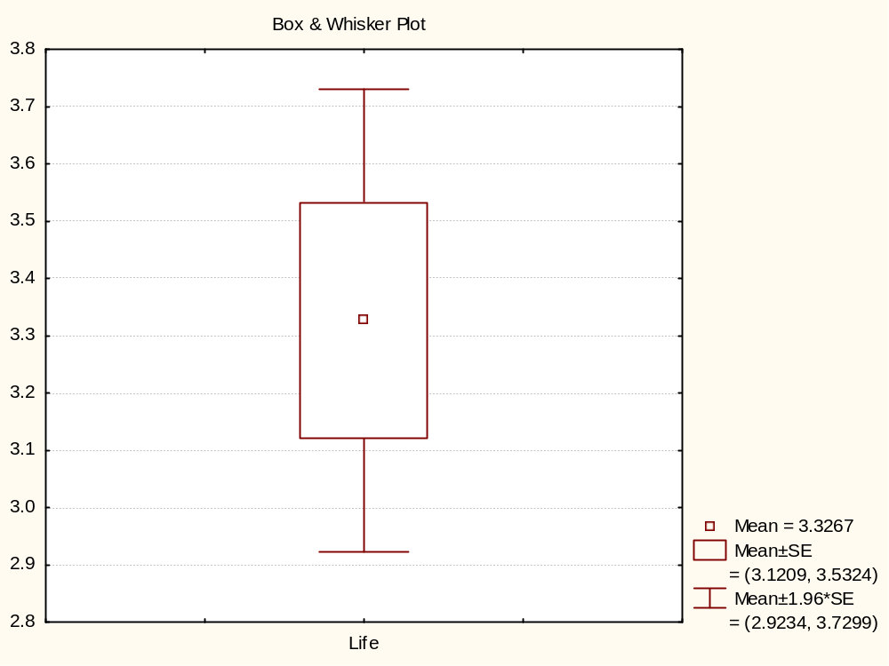
Notes:
A quick look at the Box & Whisker Plot (Mean/SE/1.96*SE version) shows that:
the value of “3.0” is not captured by Mean + SE = (3.1, 3.5);
the value of “3.0” is captured by Mean + 1.96*SE = (2.9, 3.7).
What does this mean? Stay tuned...

Slide 33
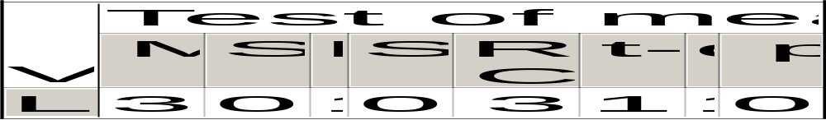
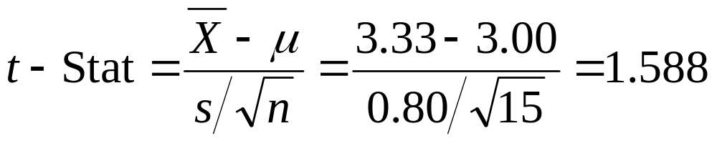
Statistica Results
Notes:
Back on the Quick tab:
Test all means against: “3”, since H₀: μ = 3 vs. H_{a}: μ ≠ 3
Click the “Summary” button.

Slide 34
2-Sided t-Test Critical t Values
α /2 = 0.025
α /2 = 0.025
Reject H₀
Reject H₀
???
0
???
t
Notes:
What are the distances for the “goal posts”, i.e., critical values?
We were given:
α = 0.05, α/2 = 0.025
n = 15, df = n - 1 = 15 – 1 = 14
Use Statistica’s Probability Distribution Calculator to find the critical values.

Slide 35
Notes:
Statistica’s Probability Distribution Calculator
Select Distribution: “t (Student)”
df = 14
p = 0.05
Check:
Inverse
Two-tailed
(1-Cumulative p)
Statistica’s PDC gives a critical value of 2.145, and, given the symmetry of the t-distribution, the other side is –2.145.
Therefore the “goal posts” go at –2.145 and 2.145.

Slide 36
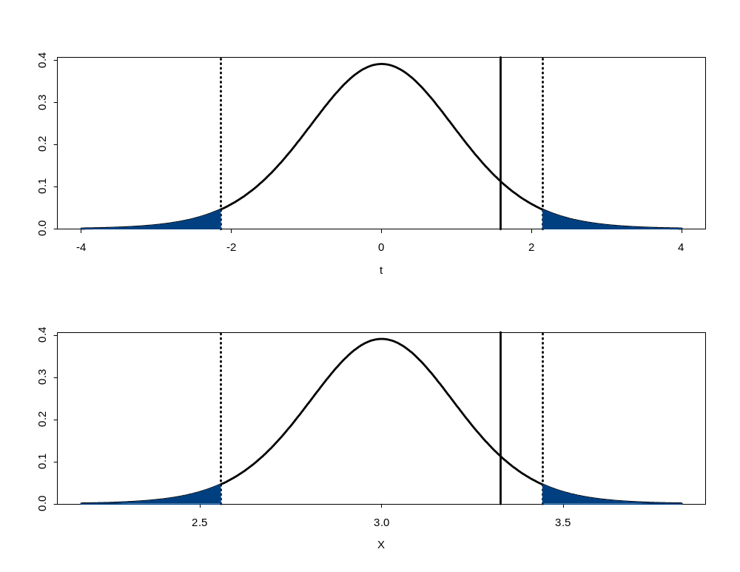
t Scale
t-Stat = 1.588
-2.145
2.145
0.025
0.95
0.025
Original Scale
X = 3.33
2.56
3.44
0.025
0.95
0.025
Notes:
Decision: Do not reject H₀ at α = 0.05.
Conclusion: There is not enough evidence to show average life is not 3 years.

Slide 37
2-sided t-Test p-Value Solution
1/2 p-value
1/2 p-value
-1.588
0
1.588
t₁₄
Notes:
Returning to the battery life data...
To find the 2-sided t-Test p-value, use the distribution of t-stat (observed).
2-sided implies looking at both possibilities: 1.588 and -1.588

Slide 38
Notes:
Using Statistica’s Probability Distribution Calculator, lookup -1.588 and 1.588 for at t distribution with 14 degrees of freedom.
Select Distribution: “t (Student)”
t = 1.588 (sample t-stat value)
df = 14
Check:
Two-tailed
(1-Cumulative p)
P(t₁₄<-1.588) = 0.0673
P(t₁₄> 1.588) = 1 - P(t₁₄<1.588) = 1 - 0.9327 = 0.0673
p-value = P(t₁₄ < -1.588 or t₁₄ > 1.588) = 0.0673 + 0.0673 = 0.135

Slide 39
2-sided t-Test p-Value Solution
1/2 p-value = 0.0673
1/2 p-value = 0.0673
Reject
Reject
α/2 = 0.025
α/2 = 0.025
-1.588
0
1.588
t₁₄
Notes:
p-value = 0.135 > α = 0.05
Do not reject H₀

Slide 40
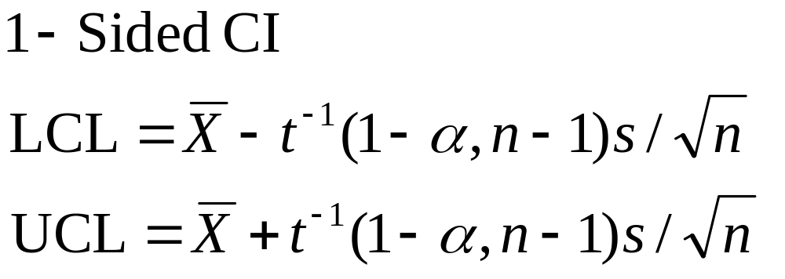
1-Sample Tests Confidence Intervals
Notes:
The 2-sided version both adds and subtracts a value from the means.
And the area in the tails is divided equally on both sides.
The 1-sided version either adds or subtracts a value from the means.
And the area in the tail is not divided by 2.

Slide 41
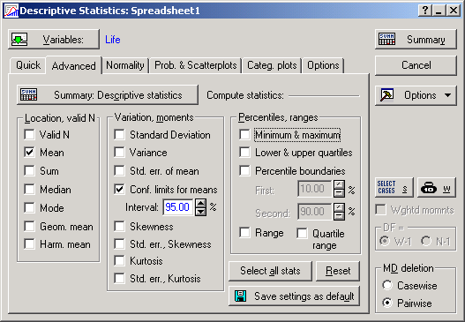
Notes:
Statistica Analysis
Statistics > Basic Statistics/Tables > Descriptive Statistics

Slide 42

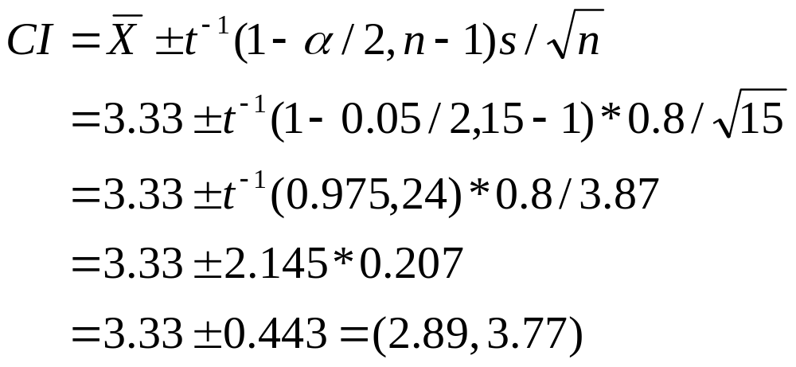
Statistica Results
Notes:
CI contains 3.00, so do not reject H₀

Slide 43
95% Confidence Interval
H₀: μ = 3
LCL = 2.89
UCL = 3.77
0.025
0.95
0.025
Notes:
Because the hypothesized value (3) falls between the confidence limits (2.89 and 3.77), do not reject H₀.

Slide 44
1-Sided t-Test Example
H₀: μ < 3 vs. H_{a}: μ > 3
Notes:
Is the average life of a battery greater than 3 years?
A random sample of 15 batteries showed a mean = 3.33 years and a standard deviation of 0.80 years.
Test using 95% confidence (α = 0.05).

Slide 45
1-Sided t-Test Solution
Reject H₀
0.05
t
0
???
Notes:
H₀: μ < 3 vs. H_{a}: μ > 3
Data does not change and the test statistic (1.588) does not change; only the critical value and p-value change!

Slide 46
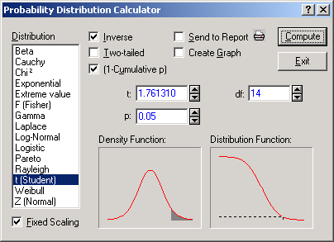
Notes:
Use Statistica’s Probability Distribution Calculator to find the 1-Sided t-Test Critical t Value.
Select Distribution: “t (Student)”
df = n – 1 = 15 – 1 = 14
α = 0.05
Check:
Inverse
(1-Cumulative p)
Critical Value is 1.76.

Slide 47
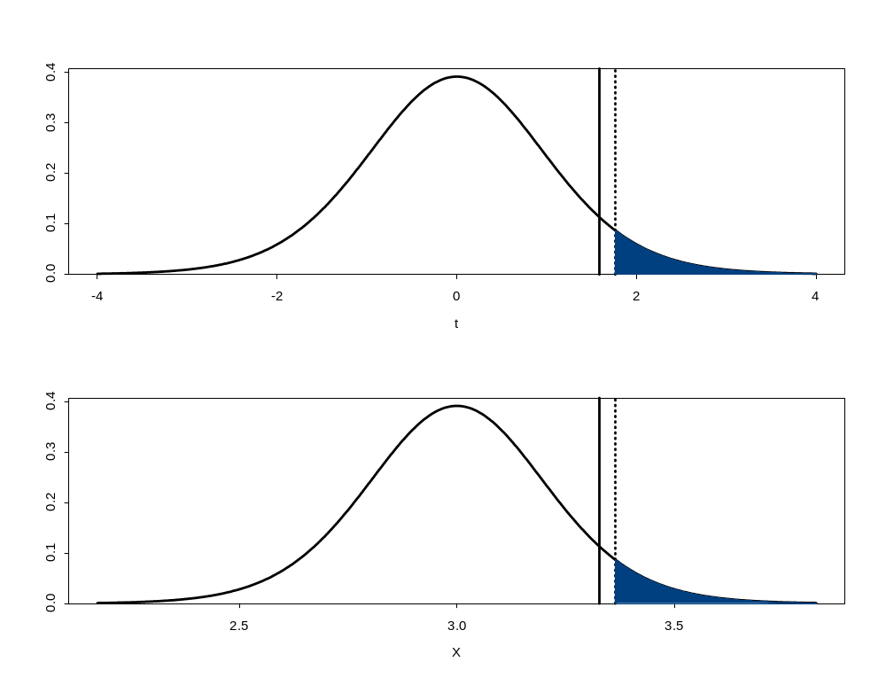
t Scale
t-Stat = 1.588
1.761
0.95
0.05
Original Scale
X = 3.33
3.36
0.95
0.05
Notes:
Decision: Do not reject at α = 0.05.
Conclusion: There is not enough evidence to show average life is greater than 3 years.

Slide 48
1-Sided t-Test p-Value Solution
p-value = ?
0
1.588
t₁₄
1.80
Notes:
Use alternative hypothesis to find direction
Find the area to the right of the t-stat value.

Slide 49

Notes:
Use Statistica’s Probability Distribution Calculator to lookup 1.588 for a t distribution with 14 degrees of freedom.
Select Distribution: “t (Student)”
df = 14
t = 1.588
Check “(1-Cumulative p)”
P(t₁₄ > 1.588) = 1 - P(t₁₄<1.588) = 1 - 0.9327 = 0.0673
p-value is P(t₁₄ > 1.588) = 0.0673

Slide 50
1-Sided t-Test p-Value Solution
α = 0.05
p-value
= 0.0673
0
1.588
t₁₄
Notes:
p-value = 0.0673 > α = 0.05
Do not reject H₀

Slide 51
Recall: 1-Sample Tests Confidence Intervals
Notes:
Before we looked at the 2-Sided CI version.
Now we will look at the 1-Sided CI version.

Slide 52
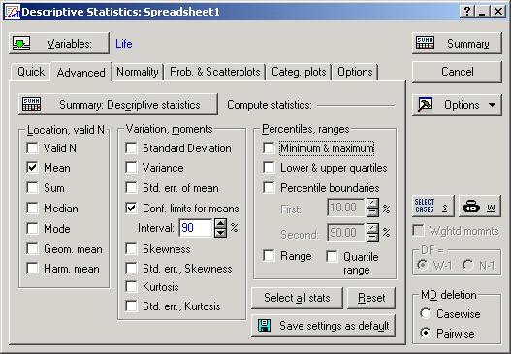
Notes:
Statistica Analysis for Battery CI Approach
Statistics > Basic Statistics/Tables > Descriptive Statistics
Recall that a 2-sided 90% Confidence Interval = 1-sided 95% Confidence Limit, so enter “90” for the confidence interval %.

Slide 53
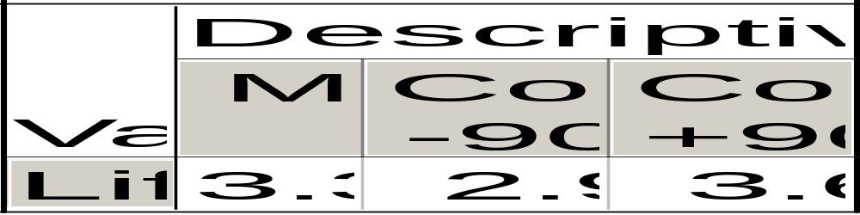
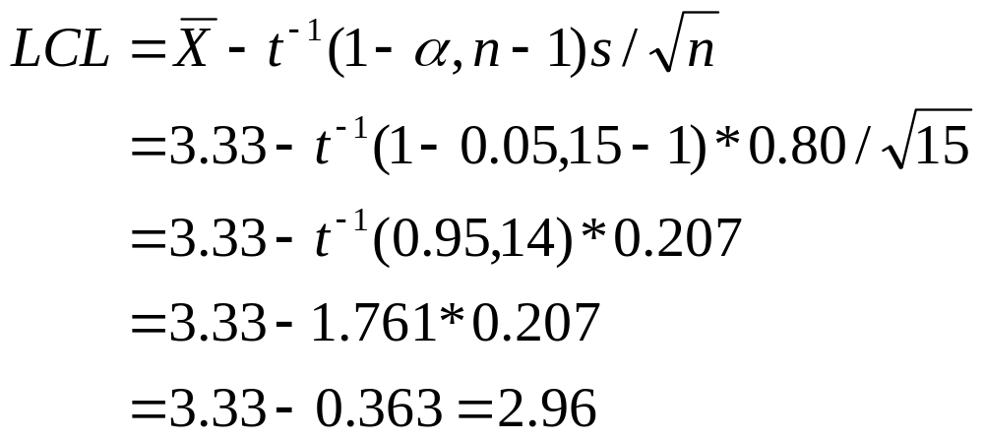
Statistica Results
Notes:
LCL is less than 3.00, so do not reject H₀

Slide 54
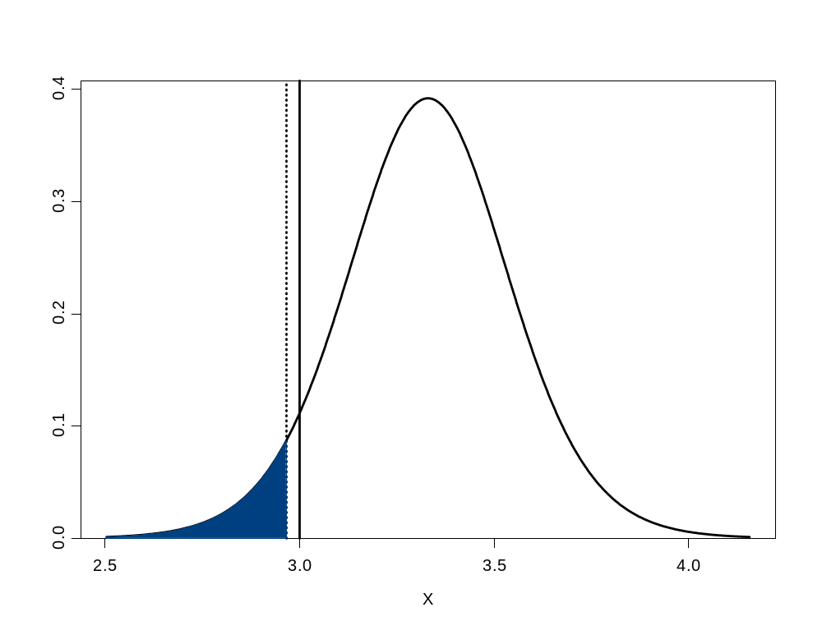
95% Confidence Interval
H₀: μ < 3
LCL = 2.96
0.05
0.95
Notes:
In other words, the CI is (2.96, +infinity), which contains 3.00, so do not reject H₀.
Conclusion
95% 1-sided CI for the mean is (2.96, +infinity).
We are 95% confident that the true mean is greater than 2.96.
Because it contains 3, we do not reject the null hypothesis H₀: μ < 3.
If we rejected the null hypothesis, we could be wrong more than 5% of the time.
This is deemed to be an unacceptable risk for α = 0.05.

Slide 55
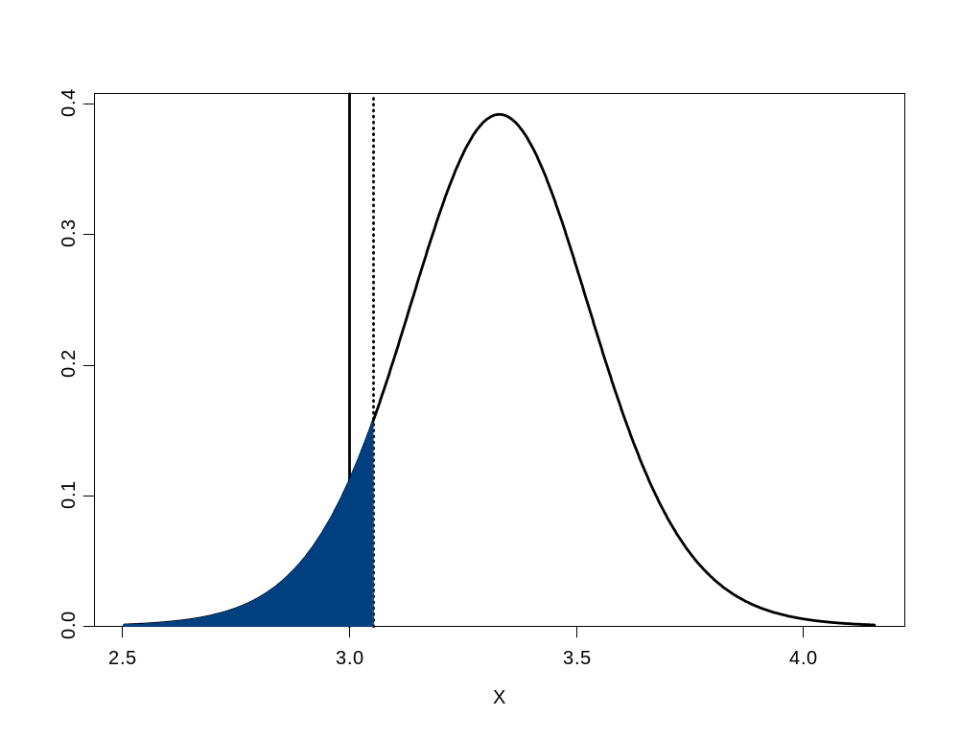
Suppose we make a 90% Confidence Interval
H₀: μ < 3
LCL = 3.05
0.10
0.90
Notes:
Reject H₀
Conclusion
90% 1-sided CI for the mean is (3.05, +infinity).
We are 90% confident that the true mean is greater than 3.05.
Because it does not contain 3, we reject the null hypothesis H₀: μ < 3.
We expect to be wrong less than 10% of the time.
This is deemed to be an acceptable risk for α = 0.10.

Slide 56
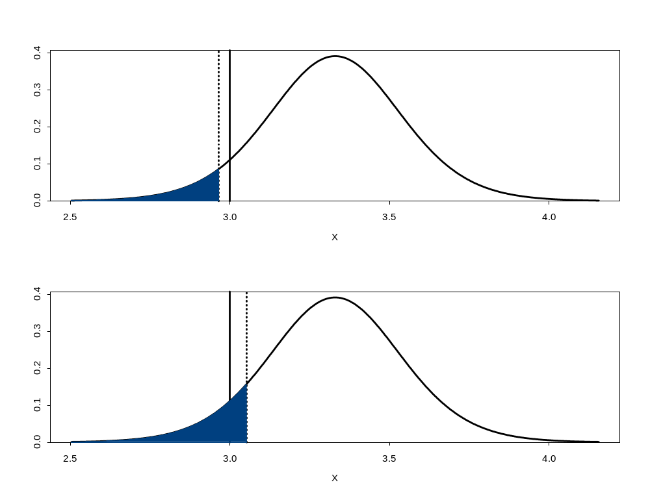
Comparison of 95% and 90% CIs
0.05
0.95
0.10
0.90
Notes:
Do not reject H₀ using 95% confidence CI.
Reject H₀ using 90% confidence CI.

Slide 57

93.3% Confidence Interval Based on p-value
H₀: μ < 3
LCL = 3.00
0.067
0.933
Notes:
What to do?
Conclusion
93.3% 1-sided CI for the mean is (3.00, +infinity).
We are 93.3% confident that the true mean is greater than 3.00.
If we rejected the null hypothesis H₀: μ < 3, we could be wrong 6.7% of the time.
It’s up to you whether this is acceptable.
This is why people often prefer p-values: observed level of significance, i.e.,
Probability of observing results given the null hypothesis is true.

Slide 58

So what?
Notes:
Confidence intervals show the variability of your data and quantify the risks of making a decision.
Try to find the highest confidence interval to match your null hypothesis, and, if the risks are acceptable, reject the null hypothesis.
Otherwise, do not reject the null hypothesis, i.e., not enough evidence to make a decision.

Slide 59
1-Sample χ²-Test
  χ²-Stat = (n - 1)*(s / σ)² ~ χ²_{n-1}
  s = Sample standard deviation
  σ = Hypothesized standard deviation
  n = Sample size
Notes:
Use with Normal data.
Test whether sample standard deviation is equal to a hypothesized value.

Slide 60
Example
H₀: σ = 0.70
H₁: σ ≠ 0.70
Notes:
15 batteries were tested.
Historical standard deviation = 0.70 years.
Has the historical standard deviation changed?

Slide 61
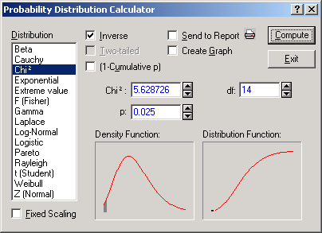
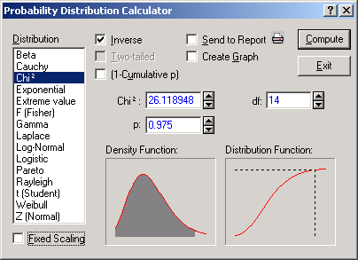
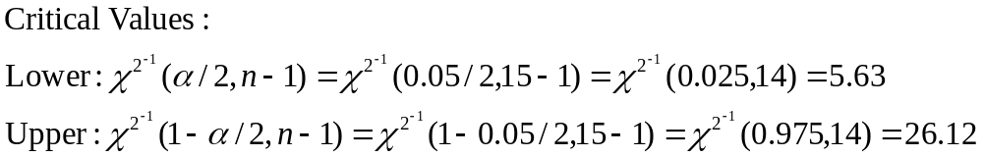
Example (cont.)
Notes:
Statistica’s Probability distribution Calculator only gives one Chi² value at a time, so you need to calculate each side, Lower and Upper, individually.
Select Distribution: “Chi²”
The degrees of freedom are the same: 14.
For 2-sided 95% confidence, the Lower critical value is the 2.5%-ile, and the Upper critical value is the 97.5%-ile. These are the values of “p”.
The values are 5.63 and 26.12, respectively.

Slide 62
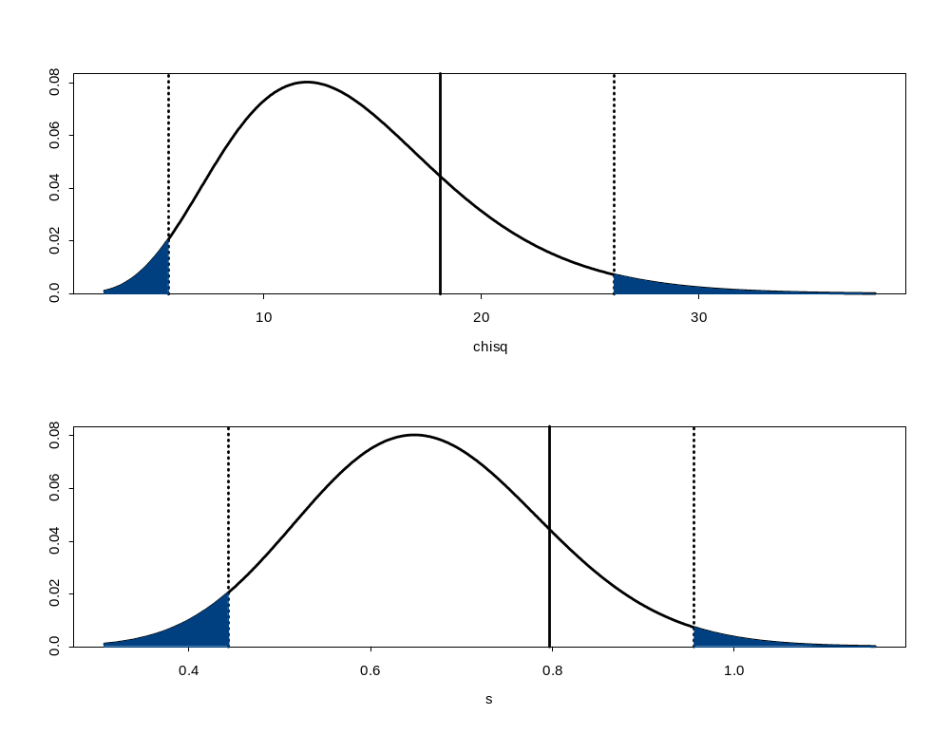
χ² Scale
χ² -Stat = 18.14
5.63
26.12
0.025
0.95
0.025
Original Scale
s = 0.80
0.44
0.96
0.025
0.95
0.025
Notes:
χ²-Stat of 18.14 is between lower and upper critical values, so do not reject H₀.

Slide 63
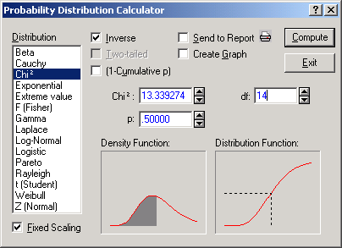
Notes:
1-Sample χ2-Test p-value
If the observed χ²-Stat value is larger than the median χ²(n-1) value, the 2-sided p-value is twice the area to the right of the observed χ²-Stat value.
Otherwise, the 2-sided p-value is twice the area to the left of the observed χ²-Stat value.
Battery Example p-value
Statistica’s PDC with Distribution = “Chi²”, df = 14, p = 0.5, and check “Inverse” gives Chi² = 13.34, which is greater than the observed value of 18.14.
Therefore, determine the area to the right of 18.14.

Slide 64
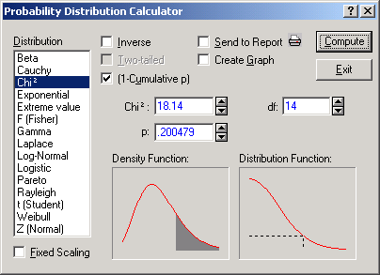
Notes:
Battery Example p-value - continued
Statistica’s PDC with Distribution = “Chi²”, df = 14, Chi² = 18.14, and check “(1-Cumulative p)” gives p = 0.20, so the p-value is 2*0.20 = 0.40.

Slide 65
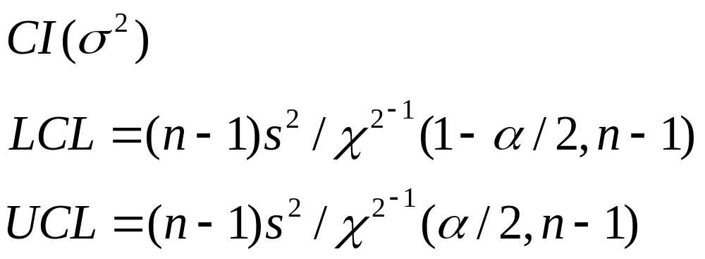
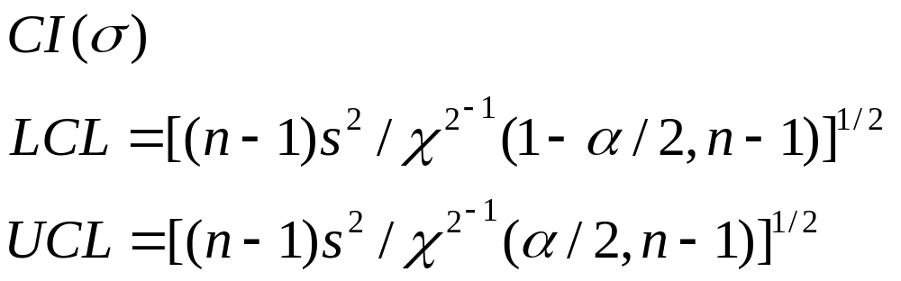
1-Sample χ²-Test Confidence Intervals
Notes:
Work with the the variance confidence interval and then take the square root to obtain the standard deviation confidence interval.

Slide 66
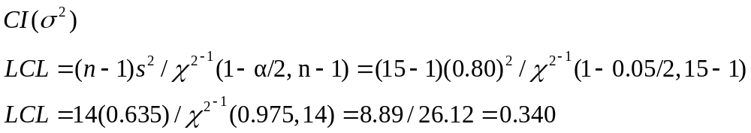
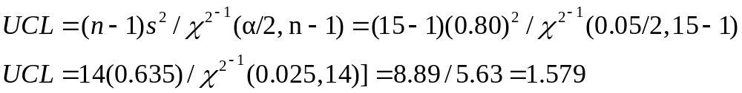
Battery CI Approach
Notes:
CI contains 0.70, so do not reject H₀.

Slide 67
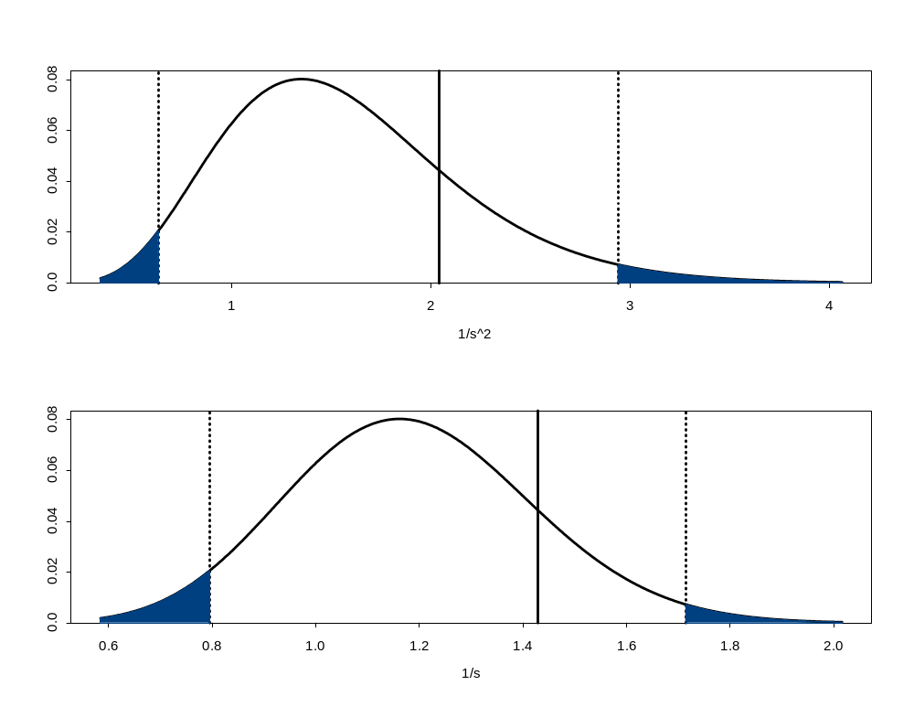
95% Confidence Interval – Inverse of s
H₀: 1/σ² = 1/(0.70)²
LCL =
1/1.579
UCL = 1/0.340
1/s² Scale
0.025
0.95
0.025
H₀: 1/σ = 1/(0.70)
LCL =
1/1.26
UCL = 1/0.58
1/s Scale
0.025
0.95
0.025
Notes:
Because the hypothesized value (0.70) falls between the confidence limits (0.58 and 1.26), do not reject H₀.
Note: it takes a very large sample size to detect a difference (or change) in the standard deviation.

Slide 68
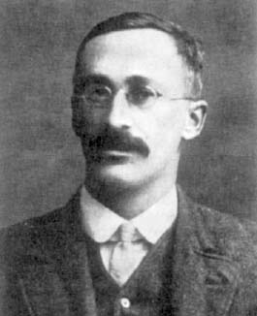

The Real Student t – “Brilliant!”
“W. S. Gossett (1908) discovered the distribution through his work at the Guinness brewery. At that time, Guinness did not allow its staff to publish, so Gossett used the pseudonym Student.”
Notes:
[Picture from http://www-groups.dcs.st-andrews.ac.uk/~history/PictDisplay/Gosset.html]
[Quote from http://www.mathworks.com/access/helpdesk/help/toolbox/stats/prob_d28.html]
Review
Do you know when and how to use:
1-Sample t-Test and CI?
1-Sample χ² -Test and CI?
Do you know when and how to use:
1-Sample 2-Sided test?
1-Sample 1-Sided test?

Slide 69




Tests of Comparison
Notes:
2-Sample Hypothesis Tests and Confidence Intervals: sampled from the same population versus sampled from different populations?
Outline
2-Sample t-Test
2-sided
1-sided
Paired t-Test
2-sided
1-sided
2-Sample F-Test
2-sided

Slide 70
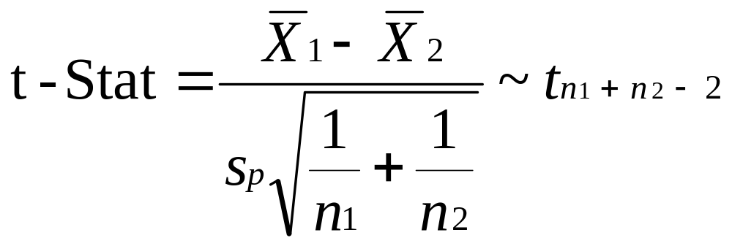
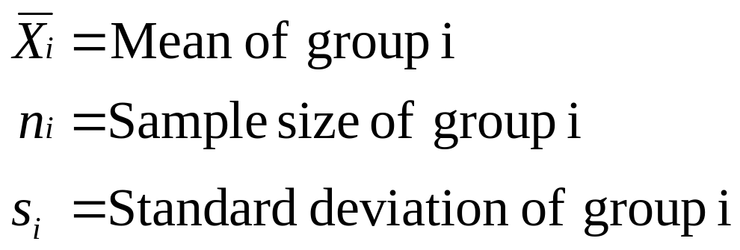
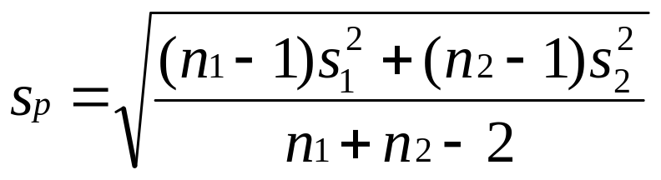
2-Sample t-Test
Notes:
Use with Normal data when standard deviations are unknown, but assumed equal.
Test whether means of 2 samples are equal.

Slide 71
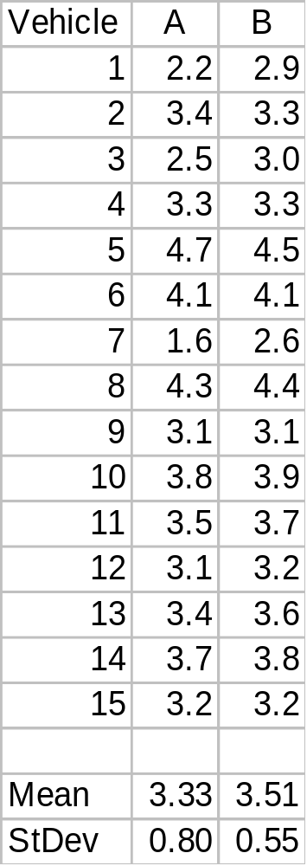

2-Sided t-Test Example
A
B
H₀: μ_{A} = μ_{B}
H₁: μ_{A} ≠ μ_{B}
Notes:
Want to compare 2 battery designs.
A is cheaper than B, but B is supposed to live longer.
15 samples of each battery were life tested of 15 different vehicles.
Determine if the batteries perform the same.
Assume standard deviations are equal for now.

Slide 72
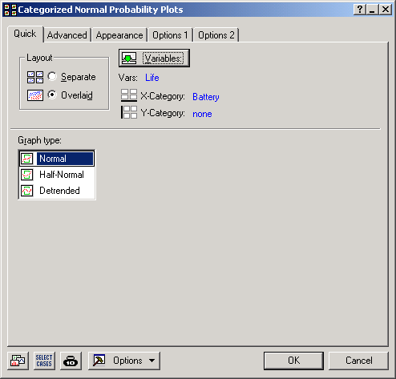
Notes:
1st Look at the Data!
To make that easier, create a spreadsheet with one column of life data (name it “Life”) and one column for the Battery name (name if “Battery”) for the codes “A” and “B.”
The go to “Graphs > Categorized Graphs” and select “Normal Probability Plots...”
Specify “Life” as the variable and “Battery” and the category (X-Category).
Make sure to select “Overlaid” and click on the “OK” button.

Slide 73
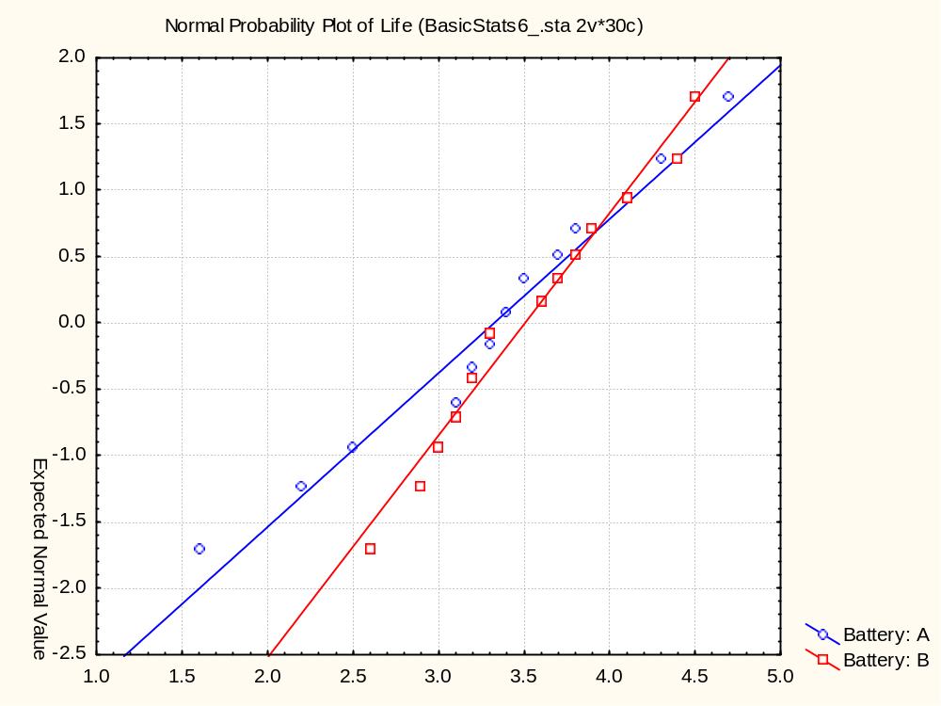
Notes:
The normal distribution appears to fit both sets of battery life data.
Are these distributions the same or different?

Slide 74
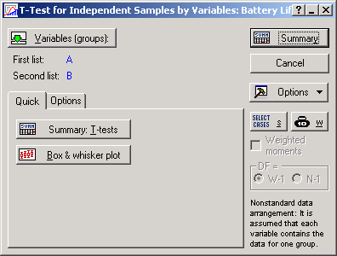
Notes:
2-Sided t-Test Example (Cont.)
First make sure your worksheet has one column of the Battery A data (named “A”) and one column for the Battery B data (named “B”).
Statistica Analysis: Statistics > Basic Statistics/Tables > t-test, independent, by variables
First list: A
Second list: B
Note: for the data we graphed, we could have used:
Statistica Analysis: Statistics > Basic Statistics/Tables > t-test, independent, by groups
but for now work with the data in separate columns – you’ll see why later.

Slide 75

Notes:
Here’s a quick look at the “Box & whisker plot.”

Slide 76



Statistica Results
Notes:
Here’s what you get when you click the “Summary: T-tests” button.

Slide 77


Notes:
Statistica’s PDC gives a critical value of 2.048, and, given the symmetry of the t-distribution, the other side is –2.048.

Slide 78


t Scale
t-Stat = -0.718
-2.048
2.048
0.025
0.95
0.025
Original Scale
-0.514
0.514
0.025
0.95
0.025
Notes:
Because the t-Stat (-0.718) falls between the critical values (-2.048 and 2.048), do not reject H₀.

Slide 79


Notes:
Battery 2-Sided t-Test p-value Solution
Statistica’s PDC gives a p-value of 0.479, which is greater than α = 0.05, so do not reject H₀.

Slide 80


t-Test Confidence Intervals
Notes:
The 2-sided version both adds and subtracts a value from the difference in the means.
And the area in the tails is divided equally on both sides.
The 1-sided version either adds or subtracts a value from the difference in the means.
And the area in the tail is not divided by 2.

Slide 81

Battery 2-sided CI Approach
Notes:
CI contains “0”, so do not reject H₀.

Slide 82

95% Confidence Interval
H₀: μ_{A} = μ_{B}
LCL = -0.69
UCL = 0.33
0.025
0.95
0.025
Notes:
Because the hypothesized difference (0) falls between the confidence limits (-0.69 and 0.33), do not reject H₀.

Slide 83

1-Sided t-Test Example
A
B
H₀: μ_{A} > μ_{B}
H₁: μ_{A} < μ_{B}
Notes:
Instead of determining if the batteries perform the same, determine if B is better than A.
Assume standard deviations are equal for now.

Slide 84

1-Sided t-Test Example (Cont.)
Notes:
The test statistic doesn’t change from before, only the critical value and p-value change.

Slide 85


Notes:
1-Sided t-Test Example (Cont.)
Statistica’s PDC gives a critical value of –1.701.

Slide 86

t Scale
t-Stat = -0.718
-1.701
0.05
0.95
Original Scale
-0.437
0.05
0.95
Notes:
Because the t-Stat (-0.718) falls between the critical values (-1.701 and +infinity), do not reject H₀.

Slide 87

Notes:
Battery 1-Sided t-Test p-value Solution
Statistica’s PDC gives a p-value of 0.2394, which is greater than α = 0.05, so do not reject H₀.

Slide 88
Recall: t-Test Confidence Intervals
Notes:
Before we looked at the 2-Sided CI version.
Now we will look at the 1-Sided CI version.

Slide 89

Battery 1-sided CI Approach
Notes:
UCL is greater than “0”, so do not reject H₀.
In other words, the CI is (-infinity, 0.25), which contains “0”, so do not reject H₀.

Slide 90

95% Confidence Interval
H₀: μ_{A} > μ_{B}
UCL = 0.25
0.95
0.05
Notes:
Because the hypothesized difference (0) falls between the confidence limits (-infinity and 0.25), do not reject H₀.

Slide 91

2-Sample t-Test Assumptions
Notes:
Data in each group follow a normal distribution.
For pooled test, the variances for each group are roughly equal.
The samples are independent: who is in the second sample doesn’t depend on who is in the first sample (and vice versa).
What happens if samples aren’t independent?
That is, they are “dependent” or “correlated.”

Slide 92


Ways Pairing Can Occur
Before
After
Notes:
When subjects in one group are “matched” with a similar subject in the second group.
When subjects serve as their own control by receiving both of two different treatments.
When, in “before and after” studies, the same subjects are measured twice.

Slide 93

Paired t-Test
  d = Mean of paired differences
  s = Standard deviation of paired differences
  n = Number of paired differences
Notes:
Use with Normal data when standard deviations are unknown, but assumed equal.
Test whether mean of paired differences is equal to 0.
Note: this should look a lot like the 1-sample t-test – it’s the same formula!

Slide 94

2-Sided Paired t-Test Example
A
B
H₀: μ_{A} = μ_{B}
H₁: μ_{A} ≠ μ_{B}
Notes:
After examining the test procedure, you discover that, in order to cover the range of products, the 15 tests were conducted with 15 different test vehicle configurations.
Does this knowledge change your conclusion?

Slide 95

Notes:
1st Look at the Data!
To make that easier, for the spreadsheet with one column of life data (named it “Life”) and one column for the Battery name (named if “Battery”) for the codes “A” and “B,”, add a column called “Vehicle” with the identification numbers 1 through 15.
The go to “Graphs > Categorized Graphs” and select “Scatterplots...”
Specify X = “Vehicle”, Y = “Life” and X-category = “Battery”.
Make sure to select “Overlaid” and click on the “OK” button.

Slide 96

Notes:
Notice anything unusual?
Hint: for each vehicle, look that the position of the blue diamonds relative to the red squares.

Slide 97

Notes:
For the Statistica analysis, use the data in the individual columns (“A” and “B”).
Statistics > Basic Statistics/Tables > t-test, dependent samples
First list: A
Second list: B

Slide 98


Statistica Results
Notes:
2-Sided Paired t-Test Example (Cont.)

Slide 99


Notes:
Statistica’s PDC gives a critical value of 2.145, and, given the symmetry of the t-distribution, the other side is –2.145.

Slide 100

t Scale
t-Stat = -2.186
-2.145
2.145
0.025
0.95
0.025
Original Scale
d = -0.18
-0.177
0.177
0.025
0.95
0.025
Notes:
Because the t-Stat (-2.186) falls outside the critical values (-2.145 and +2.145), reject H₀.

Slide 101


Notes:
Battery 2-Sided Paired t-Test p-value Solution
Statistica’s PDC gives a p-value of 0.046, which is less than α = 0.05, so reject H₀.

Slide 102

Paired t-Test Confidence Intervals
Notes:
These should look just like the confidence intervals for the 1-Sample t-test – only the variables have changed.

Slide 103


Create Difference Variable “Diff”
Notes:
Battery 2-Sided CI Approach
First create a difference variable: “Diff” in this case
Statistica Analysis: Statistics > Basic Statistics/Tables > Descriptive statistics
Select “Diff” and ask for a 95% confidence interval.

Slide 104


Statistica Results
Notes:
CI does not contain “0”, so reject H₀

Slide 105

95% Confidence Interval
H₀: μ_{A} = μ_{B}
LCL = -0.357
UCL = -0.003
0.025
0.95
0.025
Notes:
Because the hypothesized difference (0) falls outside the confidence limits (-0.357 and -0.003), reject H₀.

Slide 106

1-Sided Paired t-Test Example
A
B
H₀: μ_{A} > μ_{B}
H₁: μ_{A} < μ_{B}
Notes:
Accounting for potential differences in test vehicle configuration, can you show that battery B lives longer than battery A?

Slide 107
Statistica Results
Notes:
1-Sided Paired t-Test Example (Cont.)
The t-Stat doesn’t change, only the critical value and p-value change.

Slide 108


Notes:
1-Sided Paired t-Test Example (Cont.)
Statistica’s PDC gives a critical value of –1.761.

Slide 109

t Scale
t-Stat = -2.186
-1.761
0.05
0.95
Original Scale
d = -0.18
-0.146
0.05
0.95
Notes:
Because the t-Stat (-2.186) falls outside the critical values (-1.761 and +infinity), reject H₀.

Slide 110

Notes:
Battery Paired t-Test p-value Solution
Statistica’s PDC gives a p-value of 0.023, which is less than α = 0.05, so reject H₀.

Slide 111
Recall: Paired t-Test Confidence Intervals
Notes:
Before we looked at the 2-Sided CI version.
Now we will look at the 1-Sided CI version.

Slide 112

Create Difference Variable “Diff”
Notes:
Battery 1-Sided CI Approach
First create a difference variable: “Diff” in this case
Statistica Analysis: Statistics > Basic Statistics/Tables > Descriptive statistics
Select “Diff” and ask for a 90% confidence interval.
Recall: 2-sided 90% Confidence Interval = 1-sided 95% Confidence Limit

Slide 113


Statistica Results
Notes:
UCL is less than “0”, so reject H₀.
In other words, the CI is (-infinity, -0.035), which does not contain “0”, so reject H₀.

Slide 114

95% Confidence Interval
H₀: μ_{A} > μ_{B}
UCL = -0.035
0.95
0.05
Notes:
Because the hypothesized difference (0) falls outside the confidence limits (-infinity and -0.035), reject H₀.

Slide 115
2-Sample F-Test
  F-Stat = (s₁ / s₂)² ~ F_{n1-1, n2-1}
  s_{i} = Standard deviation of sample i
  n_{i} = Number in sample i
Notes:
Use with Normal data.
Test whether standard deviations of two samples are equal.

Slide 116
2-Sided F-Test Example
A
B
H₀: σ_{Α}/σ_{Β} = 1
H₁: σ_{Α}/σ_{Β} ≠ 1
Notes:
15 samples of each battery were life tested.
Determine if the variation in battery life is the same.

Slide 117
Notes:
2-Sided F-Test Example (Cont.)
Statistica Analysis: Statistics > Basic Statistics/Tables > t-test, independent, by variables
You’ve already done this, but maybe you didn’t notice the F-test lingering around.

Slide 118

Statistica Results
Notes:
The F-Stat is automatically calculated and shown in the second to last column for the 2-Sample t-test (and the p-value for the F-test is in the last column).

Slide 119



Notes:
Like the Chi² distribution, Statistica’s PDC will not do both sides at the same time (these distributions are not symmetric).
The lower critical value is 0.336, the upper critical value is 2.979.

Slide 120

F Scale
F-Stat = 2.063
0.336
2.979
0.025
0.95
0.025
Original Scale
s₁/s₂ = 1.44
0.579
1.725
0.025
0.95
0.025
Notes:
Because the F-Stat (2.063) falls between the critical values (0.336 and 2.979), do not reject H₀.

Slide 121


Notes:
2-Sample F-Test p-value
If the observed F-Stat is larger than 1, the 2-sided p-value is twice the area to the right of the observed F-Stat.
Otherwise, the 2-sided p-value is twice the area to the left of the observed F-Stat.
Battery p-value Solution
Since the F-Stat is larger than 1, determine the area to the right of the F-Stat (0.094) and multiply by 2 to get 0.188.
This value is greater than α = 0.05, so do not reject H₀.

Slide 122


2-Sample F-Test Confidence Intervals
Notes:
Work with the confidence interval for the ratio of the variances and then take the square root to obtain the confidence interval for the ratio of the standard deviations.

Slide 123

Battery 2-sided CI Approach
Notes:
CI contains “1”, so do not reject H₀

Slide 124

95% Confidence Interval
H₀: (σ₁/σ₂)² = 1
LCL =
0.693
UCL = 6.144
(s₁/s₂)² Scale
0.025
0.95
0.025
H₀: σ₁/σ₂ = 1
LCL =
0.83
UCL =
2.48
s₁/s₂ Scale
0.025
0.95
0.025
Notes:
Because the hypothesized ratio (1) falls between the confidence limits (0.83 and 2.48), do not reject H₀.

Slide 125

Summary of Tests
Notes:
Review
Do you know when and how to use:
2-Sample t-Test and CI?
2-Sample Paired t-Test and CI?
2-Sample F-Test and CI?
Do you know when and how to use:
2-sample 2-sided test?
2-sample 1-sided test?

Slide 126

Summary Flowchart
YES
Notes:
Here is a summary flowchart of the hypothesis testing we’ve covered in this class.
More importantly, it shows what we have not covered in this class.
We are just taking a brief peek into the wide world of statistics!

Slide 127

Notes:
http://home.ubalt.edu/ntsbarsh/Business-stat/opre504.htm

